Slide 1
Web Information Retrieval
Web Search Architecture, Crawling, Indexing, Link Analysis & PageRank

Slide 2
What is Web Information Retrieval?
• Retrieval of relevant information from the World Wide Web
• Deals with massive, dynamic, and heterogeneous data
• Foundation of modern web search engines like Google

Slide 3
Web Search Architecture
Main components:
• Web Crawler – collects web pages
• Indexer – processes and indexes pages
• Query Processor – handles user queries
• Ranker – ranks results based on relevance

Slide 4
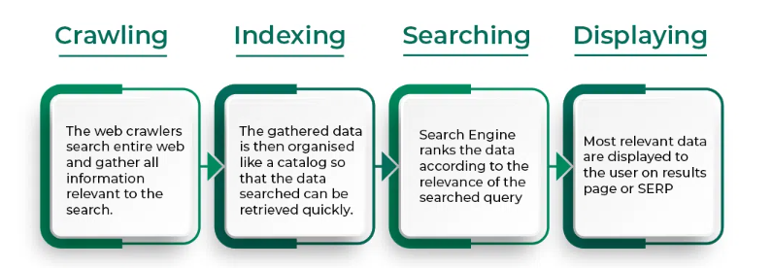
Working of Search Engine

Slide 5
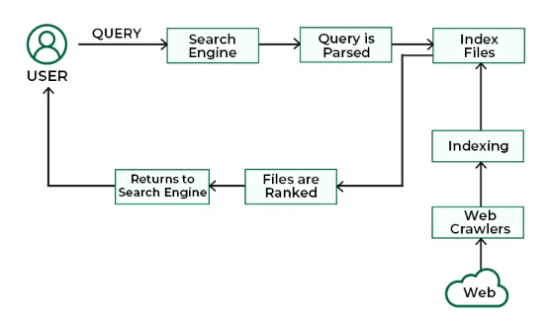
Architecture of Search Engine

Slide 6
Challenges in Web Search
• Huge scale of the web
• Dynamic and constantly changing content
• Duplicate and spam pages
• Relevance and ranking accuracy

Slide 7
Web Crawling
• Process of automatically downloading web pages
• Starts from seed URLs
• Follows hyperlinks to discover new pages
• Must be efficient and polite

Slide 8
Challenges in Crawling
• Avoiding duplicate pages
• Handling dynamic content
• Respecting robots.txt
• Managing crawl frequency

Slide 9
Indexing Web Pages
• Converts pages into searchable form
• Tokenization, stop-word removal, stemming
• Creates inverted index
• Enables fast query processing

Slide 10
Link Analysis
• Uses hyperlinks as signals of importance
• Assumption: Important pages receive more links
• Helps improve ranking quality

Slide 11
PageRank Algorithm
• Developed by Google founders
• Assigns importance score to each page
• Based on incoming links and their quality
• Uses damping factor (random surfer model)

Slide 12
Summary
• Web IR handles large-scale web data
• Crawling and indexing are core processes
• Link analysis improves ranking
• PageRank is a key web ranking algorithm

